Slide 1
UNITY 2D FIGHTING BASE

Slide 2
ÍNDEX
Concept 3
Gameplay ?

Slide 3
CONCEPTO
1.1. General
Title – Unity 2D Fighting Base
Genre – Fighting Game
Player – One / Two Players
Tools:
Unity (ver. 2022.3.34f)
Visual Studio (C#)
Fighter Factory Studio (Sprites)
Resources:
https://www.andersonkenya1.net/files/ (Sprites)
https://mugenfreeforall.com/forum/13-collections/ (Sprites)
https://www.spriters-resource.com (UI)
https://www.models-resource.com (Models)
https://www.sounds-resource.com (Sounds)
1.2. High Concept
Is a 2D fighting game base for unity.
This project works as a starting point for the creation of a 2D fighting game, taking as an example the gameplay of SFII.

Slide 4
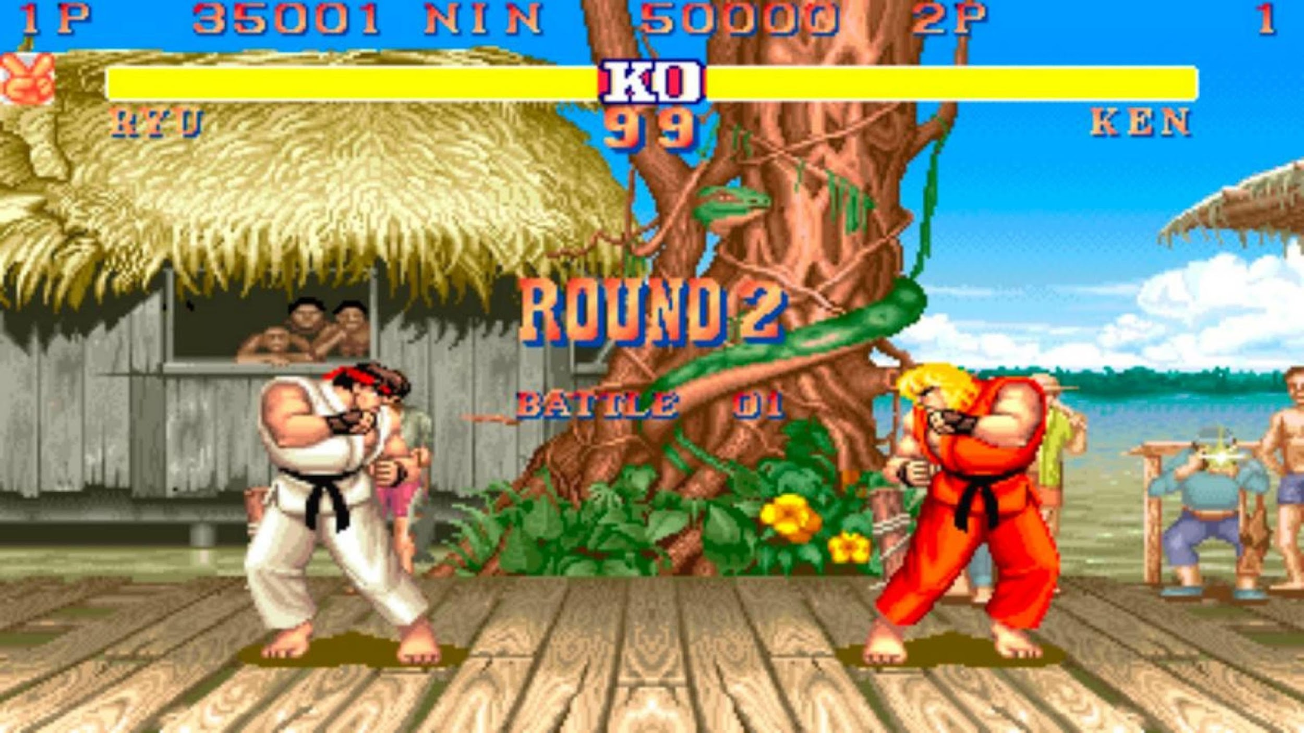
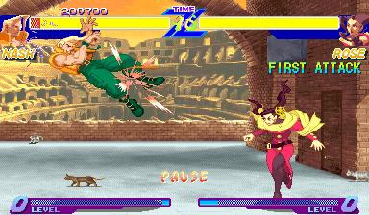
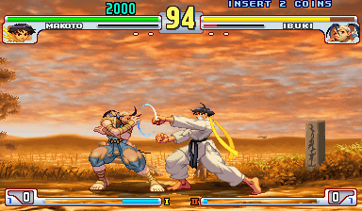
GAMEPLAY
3.1. General
The gameplay takes the core of Street Fighter II and adds some other mechanics that are standard today.
Six Button Attacks
Command Normal
Command Inputs
Special Cancel
Super and Meter
Block and Stun
Throws
Street Fighter II
Alpha Counter
Throw Tech
Quick Stand Tech
Street Fighter Alpha
Dash
EX Moves
Parry
Street Fighter III

Slide 5
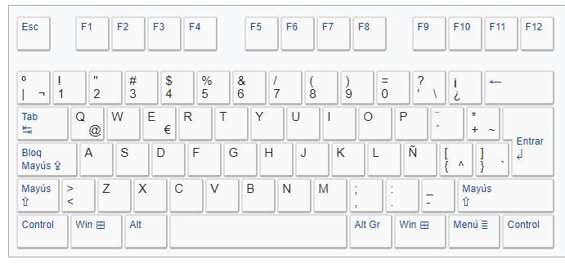
GAMEPLAY
3.2. Controls
Keyboard P1
P1 Movement
W - Up
A - Left
S - Down
D - Right

Slide 6



GAMEPLAY
3.3. Actions
Basic Movement
Horizontal Movement
Neutral Jump
/
Crouch
Diagonal Jump
/
/
/
Advance Movement
Forward Dash
Backward Dash

Slide 7
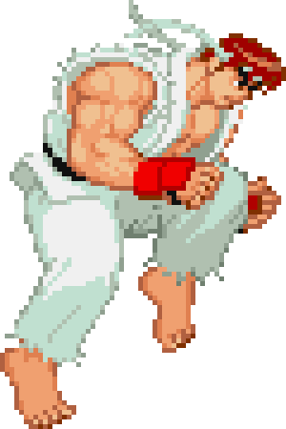
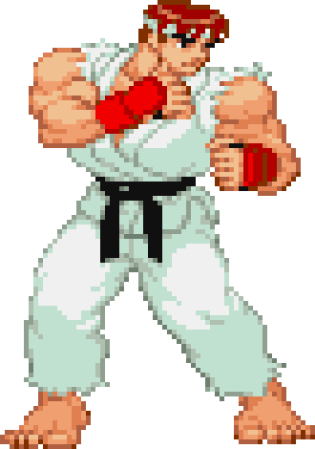
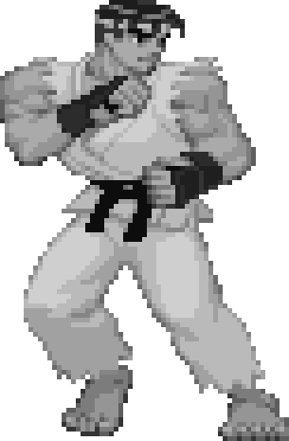
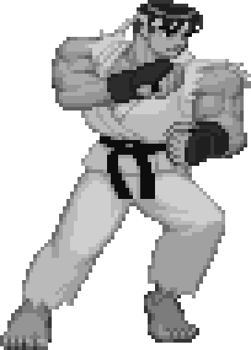
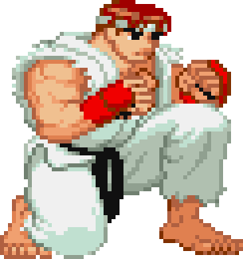
GAMEPLAY
3.4. Basic Movement
Stage States: Characters have two stage states, Grounded and Airborne, depending on whether they are on the surface or not.
Grounded
Airborne
Neutral: When Grounded, the characters are always facing the opponent and automatically turn in their direction.
Horizontal Movement: Characters can move forward and backwards. The velocity changes depending on the direction.
Grounded
Crouch: Characters can crouch in the ground, stops his movement, reduces the hitbox and gives him access to other moves.
Grounded

Slide 8
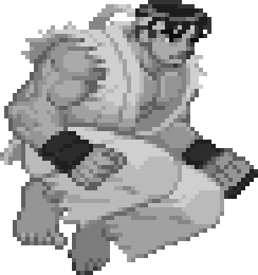
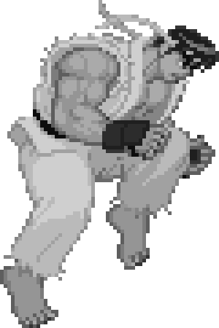
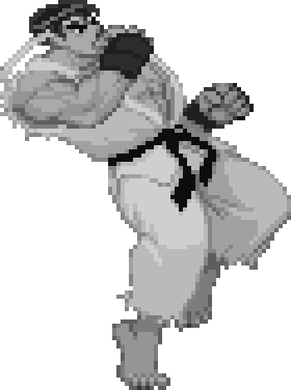
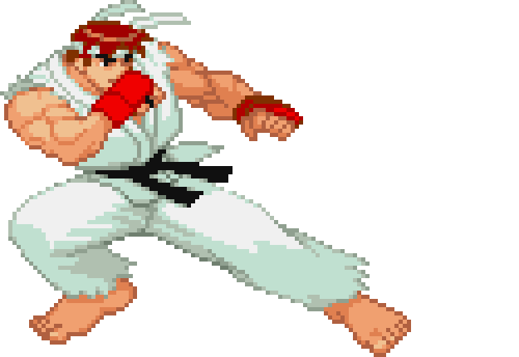
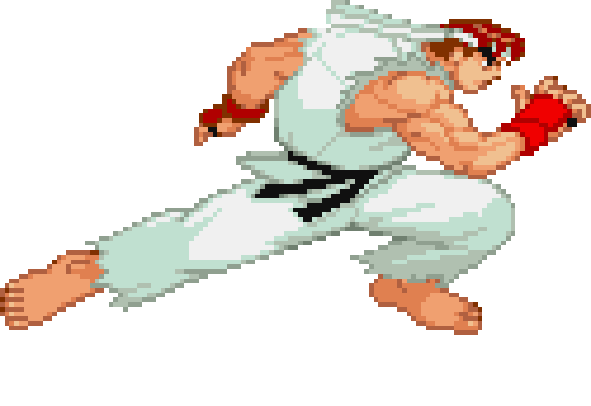
GAMEPLAY
3.4. Basic Movement
Vertical Movement: Characters can jump in three directions. The height depends on the character.
3.5. Advance Movement
Dash: Characters can dash forward and backwards, is faster than walking and can be cancel into other actions. The velocity changes depending on the direction.
Grounded

